Slide 1
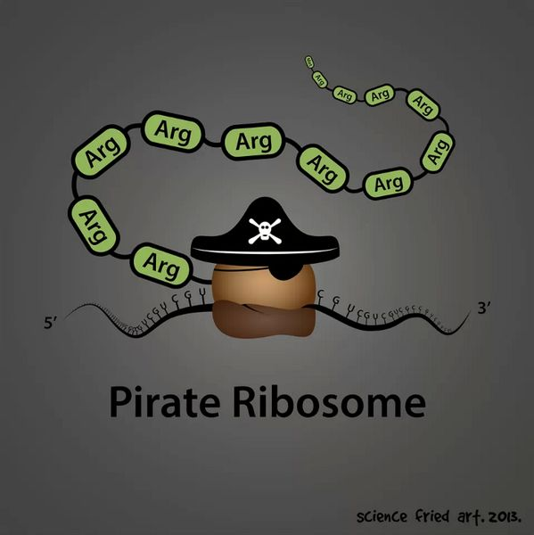
BB2950 Day 5: Tuesday 10-31-17
Learning objectives:
Design PCR primers.
Explain how gel electrophoresis is used to analyze PCR products.
Describe what DNA cloning or molecular cloning is.
Diagram a typical workflow for cloning a gene.
Describe some of the applications of DNA cloning
Explain the roles of PCR, restriction enzymes, DNA ligase, drug resistance genes, origins of replication, and E. coli in DNA cloning.

Slide 2
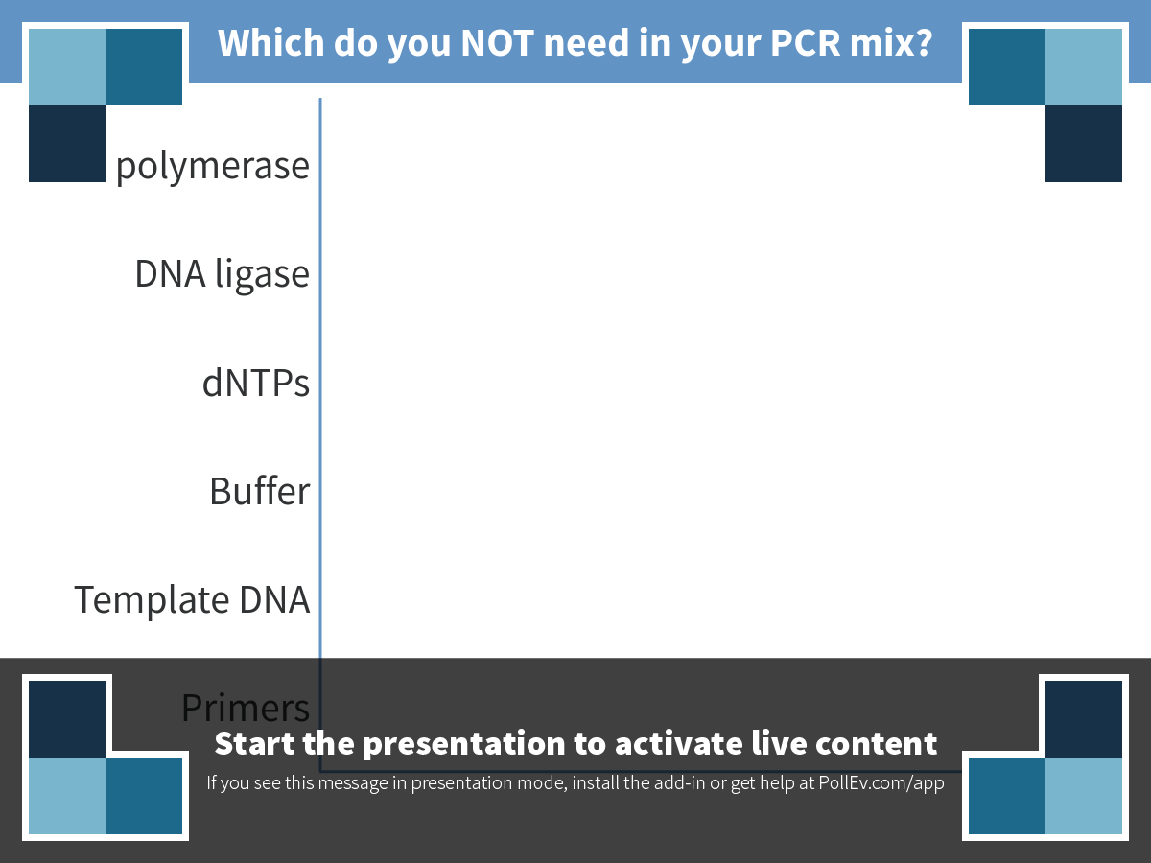
Notes:
Which do you NOT need in your PCR mix?
https://www.polleverywhere.com/multiple_choice_polls/7BizgWDLyJqTe3Q

Slide 3
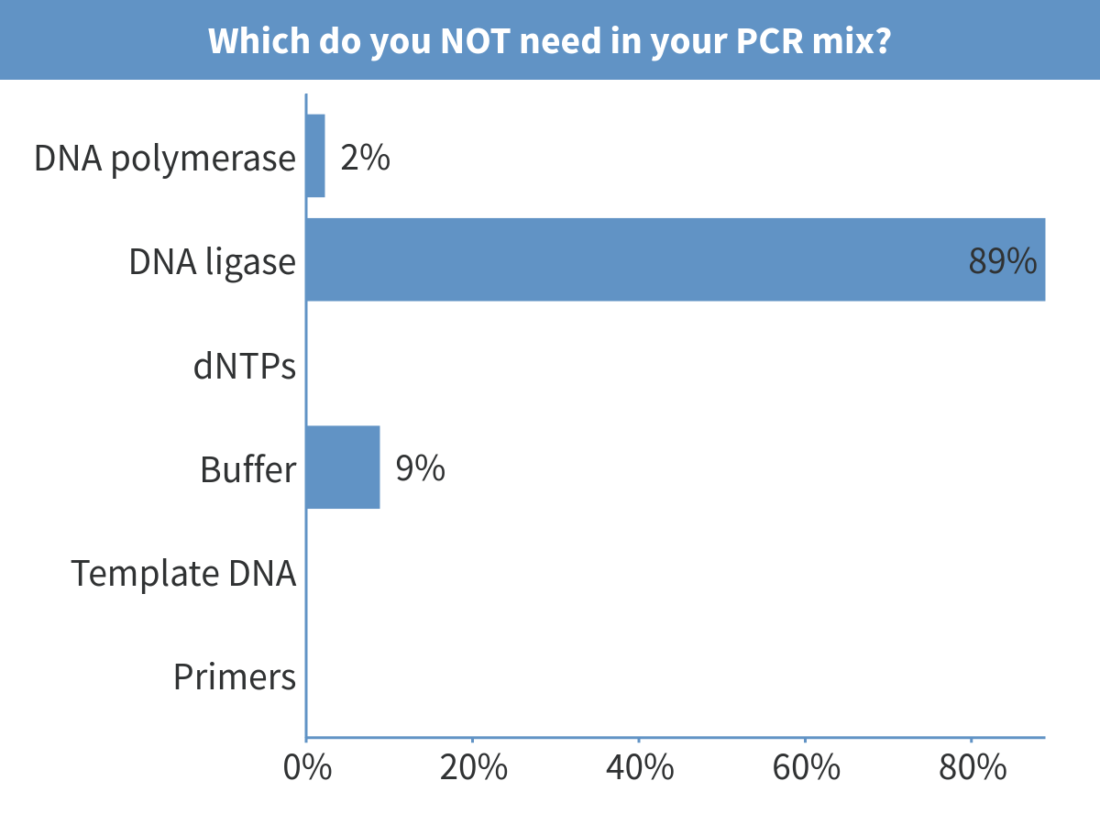
Notes:
Which do you NOT need in your PCR mix?

Slide 4
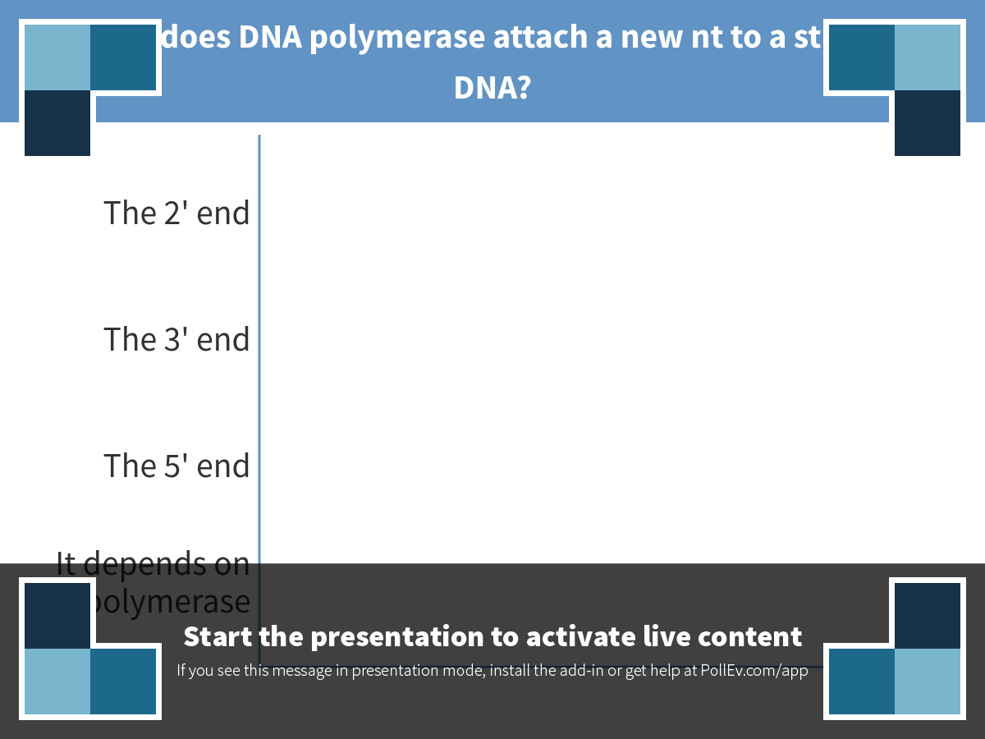
Notes:
Where does DNA polymerase attach a new nt to a strand of DNA?
https://www.polleverywhere.com/multiple_choice_polls/mP04jstXSYw0Bv6

Slide 5
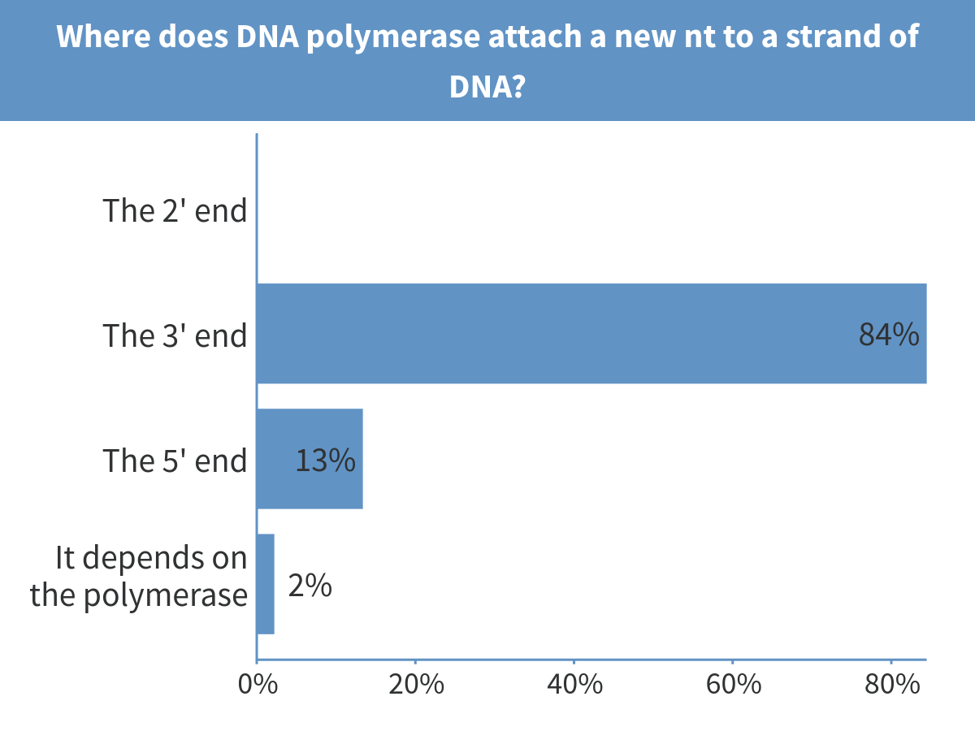
Notes:
Where does DNA polymerase attach a new nt to a strand of DNA?

Slide 6
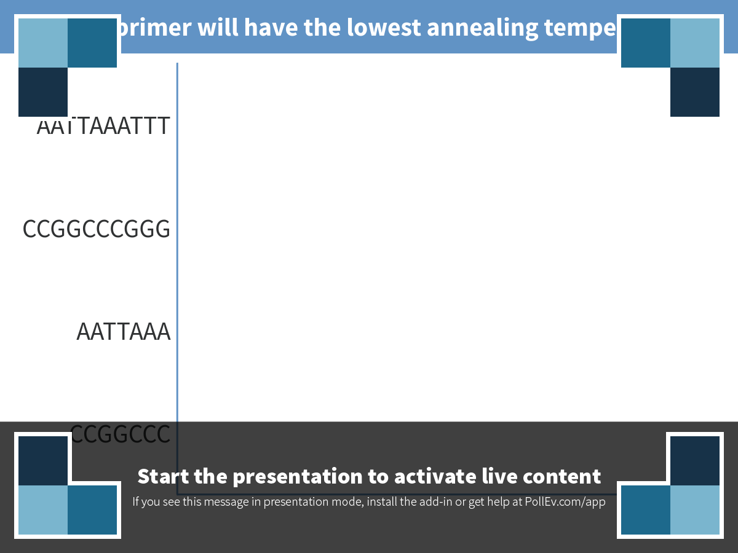
Notes:
Which primer will have the lowest annealing temperature?
https://www.polleverywhere.com/multiple_choice_polls/dVdAhRTFV7JdExV

Slide 7
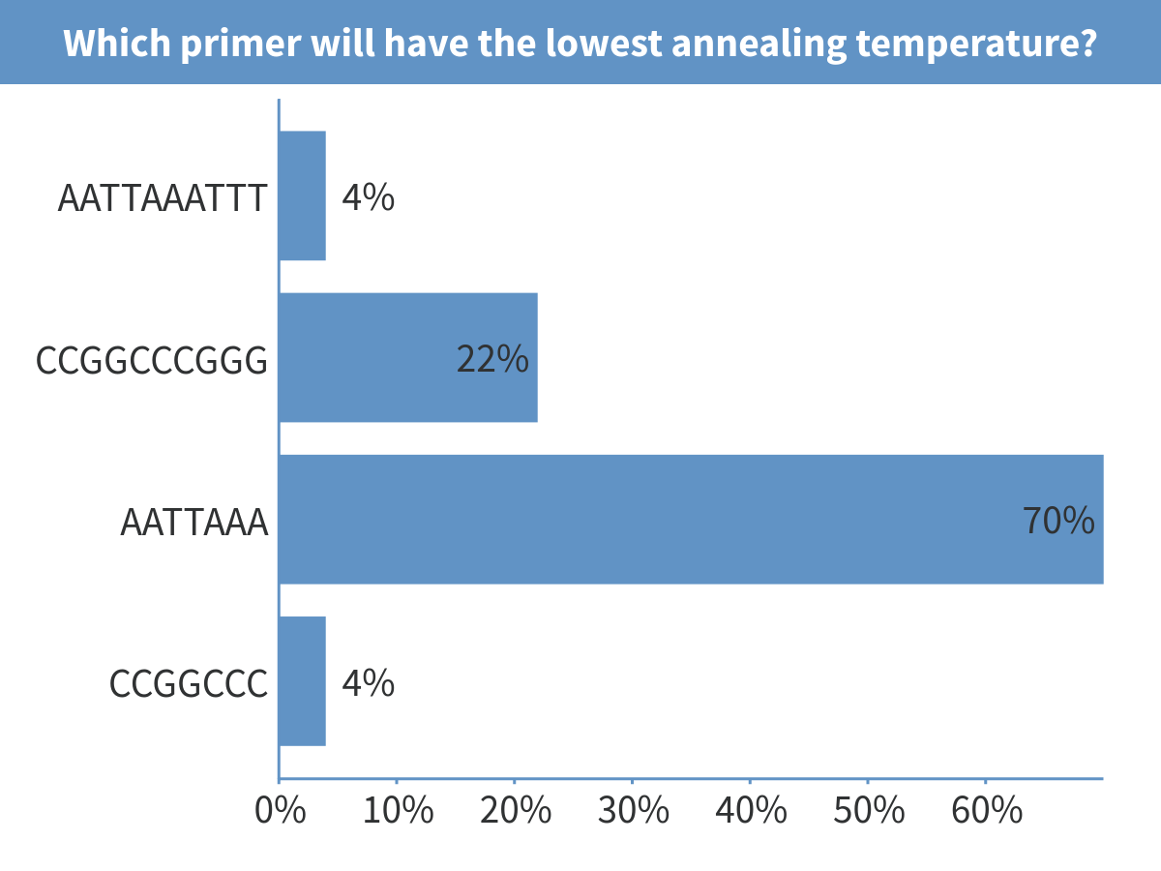
Notes:
Which primer will have the lowest annealing temperature?

Slide 8
Suppose your primers only needed to be 6 nt long. What primer sequences would you use to amplify the red sequence?
5’-ttggcagattcccgccagagcaaaacagccgctagtcctagtccg-3’
3’-AACCGTCTAAGGGCGGTCTCGTTTTGTCGGCGATCAGGATCAGGC-5’

Slide 9
Suppose your primers only needed to be 6 nt long. What primer sequences would you use to amplify the red sequence?
5’-ttggcagattcccgccagagcaaaacagccgctagtcctagtccg-3’
3’-AACCGTCTAAGGGCGGTCTCGTTTTGTCGGCGATCAGGATCAGGC-5’

Slide 10
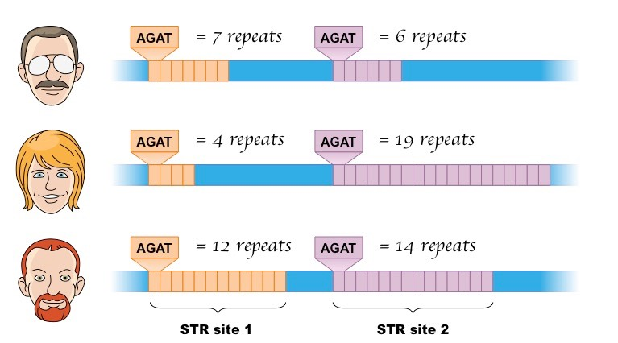
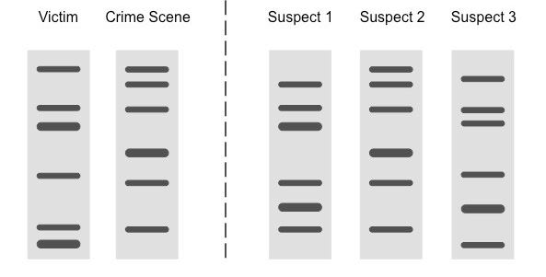
Example: PCR to amplify variable repeat sequences for forensic analysis
http://ib.bioninja.com.au

Slide 11
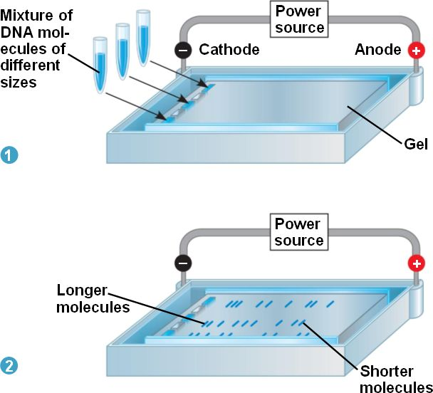
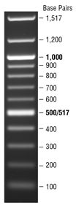
Gel electrophoresis to determine the size of DNA molecules
A DNA “ladder” from New England Biolabs
http://decodingdna.yolasite.com

Slide 12
DNA cloning/gene cloning/recombinant DNA cloning/molecular cloning

Slide 13
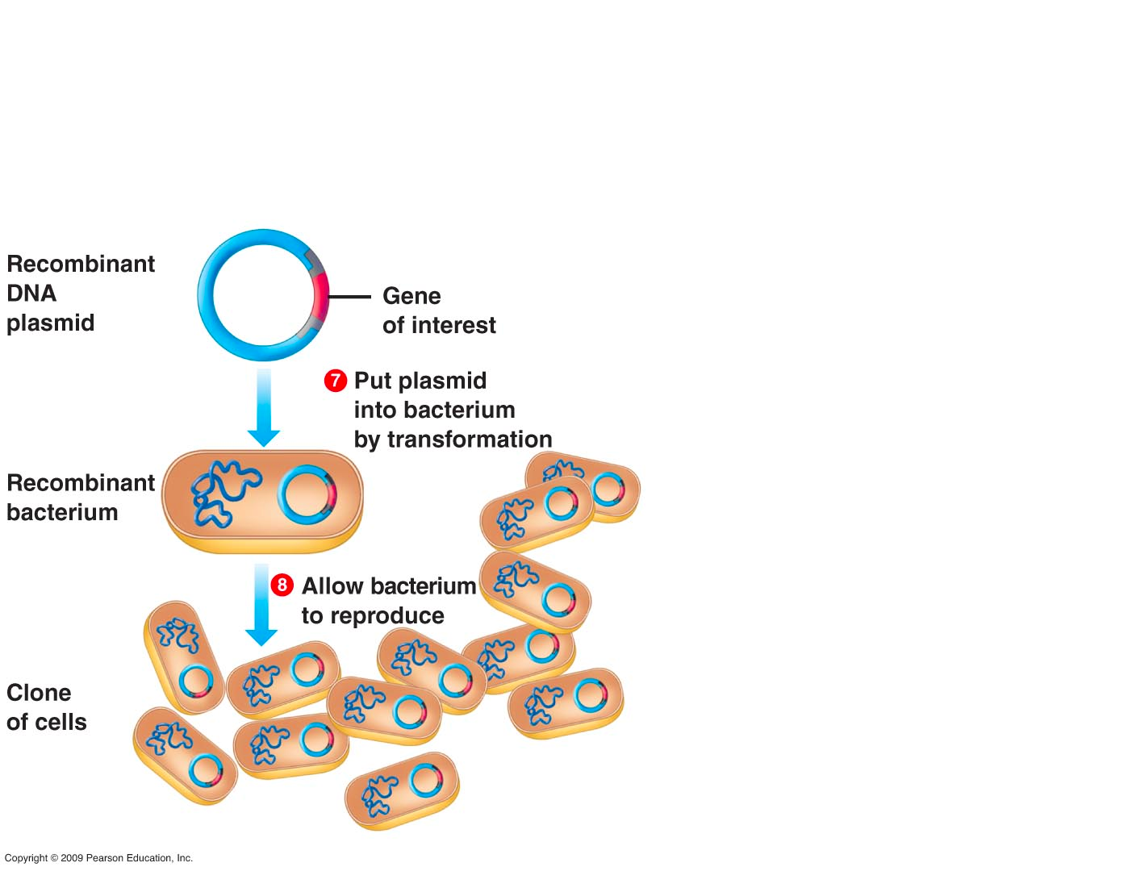
Cloning is a way to let E. coli store and replicate DNA sequences in a useful form

Slide 14
Why is cloning useful?
Produce a protein in large quantities in E. coli or another easy-to-grow organism.
Make recombinant DNA molecules that you can use in an organism of your choice:
What is the effect of a particular mutation in a gene?
What is the effect of changing the expression level of a gene?
Express a fluorescent protein in a particular cell type
Genome editing through CRISPR-cas9 or other method
E. coli allows for a selection of a correctly assembled piece of DNA, and copies DNA more cheaply and more accurately than PCR!

Slide 15
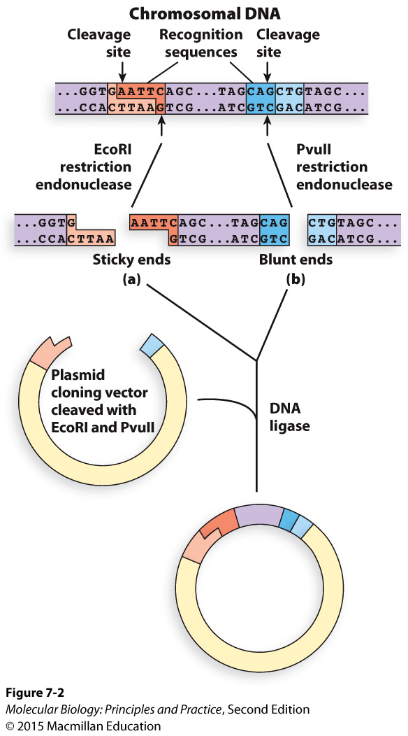
Method 1: restriction enzymes and ligation to put a DNA fragment of interest into a cloning vector (plasmid)

Slide 16
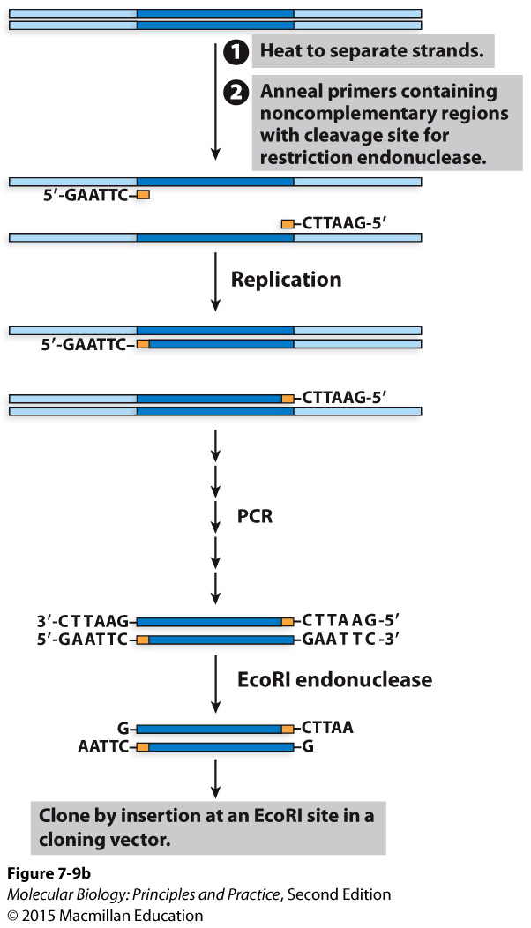
Using PCR to put restriction enzyme recognition sites on either side of your DNA of interest

Slide 17
If my goal is to put this DNA in a different organism, why do I transform my ligation into E. coli first?

Slide 18
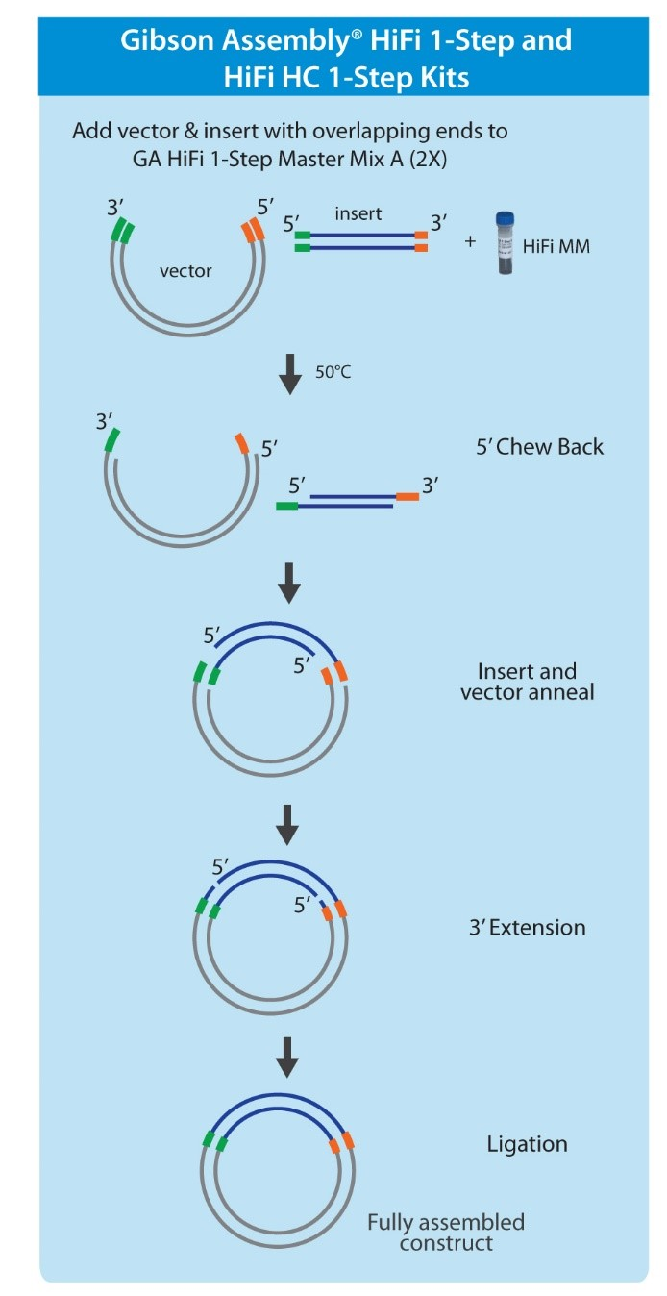
Method 2: Gibson Assembly (and closely related methods with different names)
Key advantages:
Junctions can be anywhere; no need for restriction sites
Can assemble >2 pieces simultaneously
“Scarless” assembly

Slide 19
New England Biolabs HiFI cloning manual

Slide 20
Mean: 85.3
Median: 88

